Slide 1
Dr. Borum’s Lab Ketogenic ​Therapy Application Research Database​
Octavio Ochoa
CIS4914 – Presentation 2 – Spring 2021

Slide 2
Project Overview
Topic: Clinical Research Application
Clinical Use: Data Input and Visualization & CRUD
Research Use: Query Builder, Data Analysis & Export
Motivation
Experience & Impact: Real-World Data with Potential of Helping People
Want to Learn: UI/UX Design, Web App, Python, HTML, CSS
Technical Approach
Security & Deployment: Application hosted on ResVault VM. Dockerized.
Database & Back-End: PostgreSQL Database, Python, SQLAlchemy (ORM)
Front-End: HTML & CSS Wed Design, Flask Web Framework

Slide 3
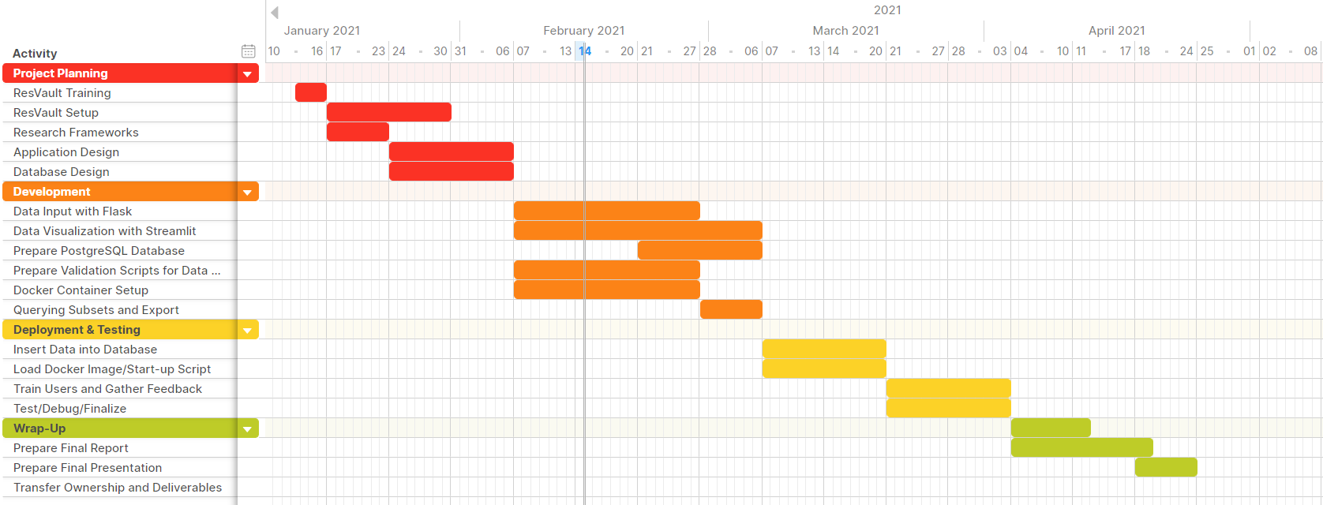
Project Plan – Gantt Chart

Slide 4
Literature Sources
[Docker] Docker.com “Reference Documentation”, Web: https://docs.docker.com/reference/, last accessed 14 February 2021.
[Flask] Flask.Palletsprojects.com “User’s Guide”, Web: https://flask.palletsprojects.com/en/1.1.x/, last accessed 23 February 2021.
[HTML/CSS] W3schools.com “W3Schools How To”, Web: https://www.w3schools.com/howto/default.asp, last accssed 23 February 2021.
[PostgreSQL] Postgresql.org “PostgreSQL 13.2 Documentation”, Web: https://www.postgresql.org/docs/13/index.html , last accessed 14 February 2021.​
[SQLAlchemy] Sqlalchemy.org “SQLAlchemy 1.3 Documentation”, Web: https://docs.sqlalchemy.org/en/13, last accessed 23 February 2021.

Slide 5
Flowchart
Patient Visit
Flask
Postgresql
Streamlit
Login to ResVault
Add New Patient
Input Data
Data to PSQL
Download to Local Machine
Open App
Select Patient
Select Source File
Input Data
Data to PSQL
Data Input
Transfer Graph to ResVault
Home Page
Data Science
View Data
View Graph
Key
Flask
Streamlit
ResVault
Select Patient
Select Source File
Select Dates
Select Data to Graph
Select File Type
Download Graph

Slide 6

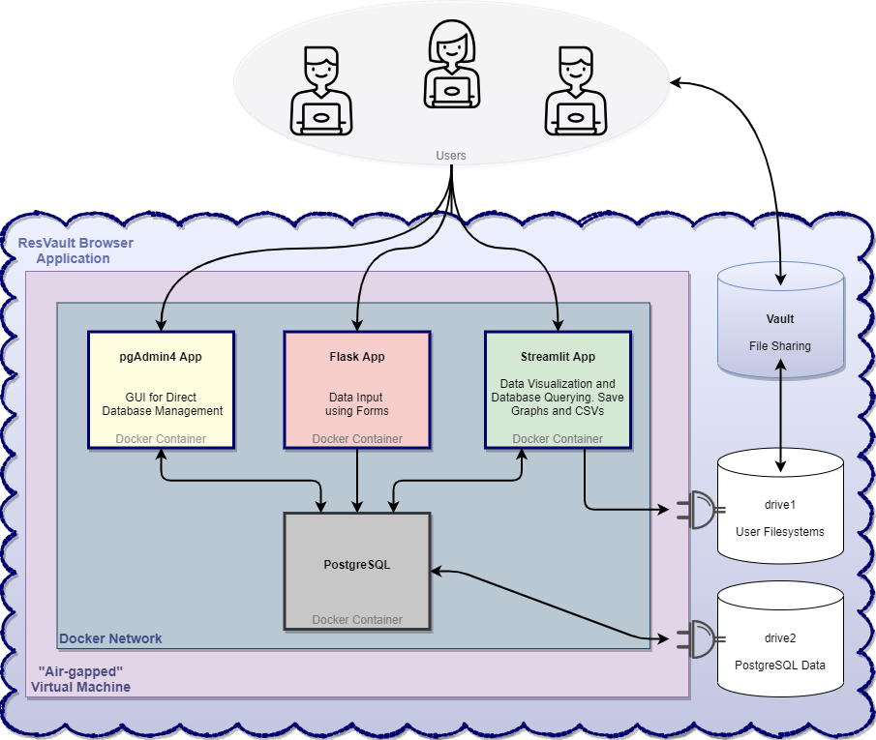

System Design

Slide 7
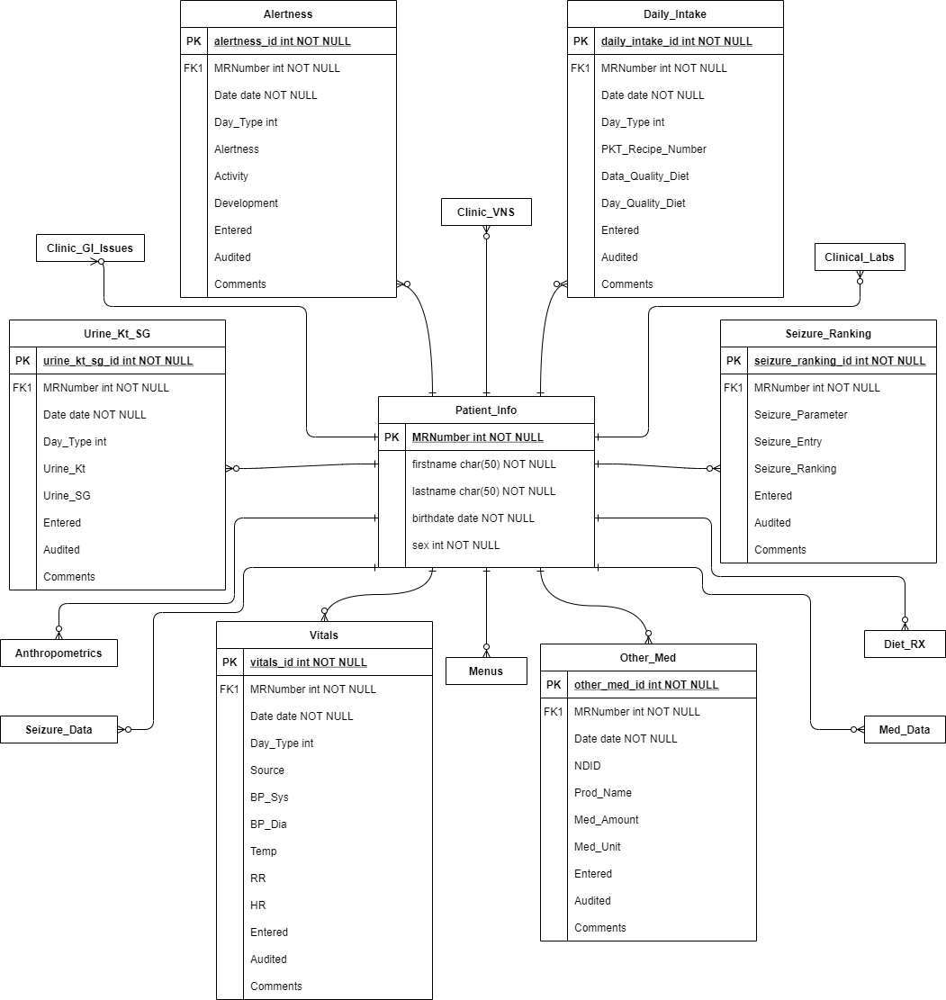
E/R Diagram
Tables
patient_info
alertness
anthropometrics
clinic_gi_issues
clinic_vns
clinical_labs
daily_intake
diet_rx
med_data
menus
other_med
seizure_data
seizure_ranking
urine_kt_sg
vitals

Slide 8
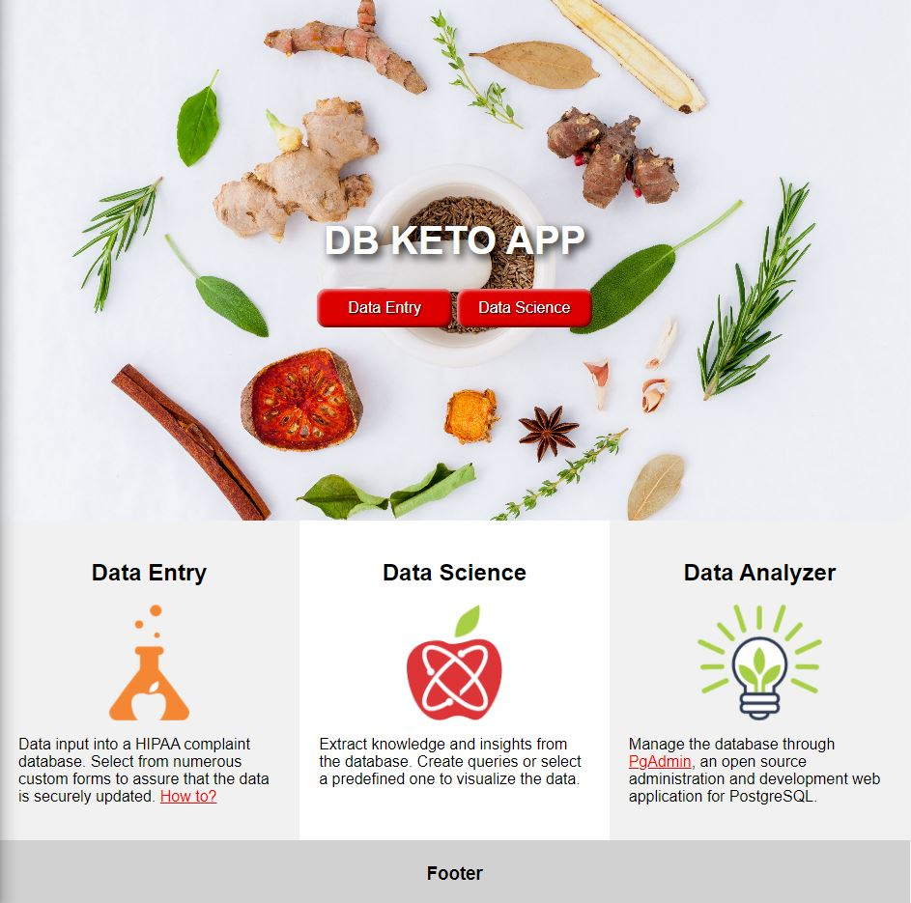
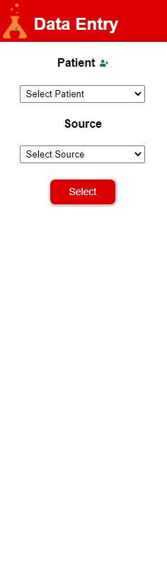
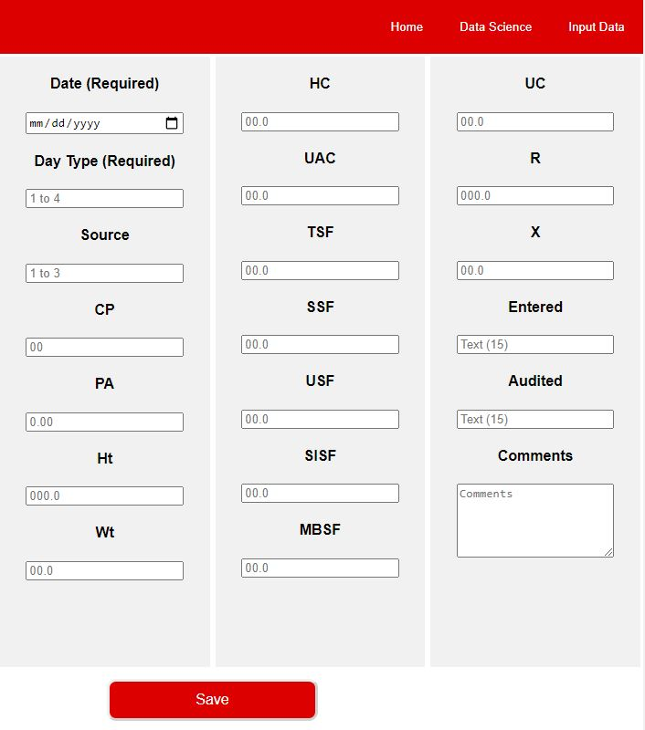
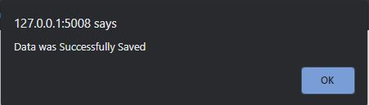
GUI Wireframes
Selection Side Bar
Data Input Form
Home Page
STREAMLIT

Slide 9
Technical Problems and Solutions
Problem: No Python nor Web Development Experience
Solution: Learn Python, CSS and HTML and Study Flask Framework
Implementation: Watch & Study Online Tutorials During Research Process
Problem: How to Structure a Web App with Different Frameworks?
Solution: A User-Friendly and Multi-Port Interactive Home Page
Implementation: The User can Access each Software From the Home Page by Clicking the Proper Links/Buttons.
Problem: How to Implement a Significant Number of Forms?
Solution: Create a Helper Software in C++
Implementation: Program auto generates the appropriate templates

